Slide 1
FLOSS : History and Evolution
Dr. Kuljit Kaur Chahal
Department of Computer Science
Guru Nanak Dev University, Amritsar, India

Slide 2
Which of the two names have you seen/heard the most?
A. Linux
B. GNU/Linux

Slide 3
Free/Libre Open Source Software (FLOSS)
Open Source Software is dominating the software industry more than ever before:
More than 90% of software products contain open source components*
*Managing your open source supply chain – why and how, IEEE Computer, 53(6), 2020

Slide 4




Is FLOSS free?
YES!
The user is free to run, copy, study, adapt, improve, distribute an open source product
The source code is in the public domain for all these actions
NO!
Software has a price.
Its not free as free beer.

Slide 5
However, software was free as free beer when*
Researchers were writing software and gladly sharing it with other researchers to port and use it
Academic principles of sharing knowledge!!!
it was bundled with hardware in 1950s and 1960s
manufacturers were happy that software was making the machines useful
Later, they found that all the users were not into maintaining the source code on their own, and wanted help.
They stopped distributing source code.
Leading player IBM's unbundling of software and hardware.
By mid 70s, proprietary software was dominating the scene
*there didn’t exist any definition of free software

Slide 6
Why Free software?
User should control the software rather than software controlling the user.
So appropriate even in the modern context?
User should have the freedom or liberty to see, and modify.

Slide 7
Four levels of freedom
(0) The freedom to run the program as you wish, for whatever purpose.
(1) The freedom to study the program's “source code,” and change it, so the program does your computing as you wish. Anyone who knows programming, and has the program in source code form, can read the source code, understand its functioning, and change it too.
(2) The freedom to make and distribute exact copies when you wish. Distributing a program to users without freedom mistreats them; however, choosing not to distribute the program—using it privately—does not mistreat anyone.)
(3) The freedom to make and distribute copies of your modified versions, when you wish.

Slide 8
Four freedoms from 0 to 3
The reason the current and definitive four freedoms are numbered 0, 1, 2 and 3 is historical.
Around 1990 there were three freedoms, numbered 1, 2, and 3.
It was then decided that the freedom to run the program needed to be mentioned explicitly.
Rather than renumber the others, freedom 0 was added.

Slide 9
People who contributed to FLOSS for what it is today
Stallman-Torvalds-Raymond’s hacker diaspora
Richard Stallman
Linus Torvalds
Eric S. Raymond
Hackers: Heroes of the Computer Revolution
Steven Levy. Hackers: Heroes of the Computer Revolution. Anchor/Doubleday. 1984. ISBN 0-385-19195-2.

Slide 10
A few others
Tim O’Reilly
Christine Peterson

Slide 11
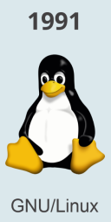
The Players : An Introduction
Richard Stallman (also known as RMS) kicked off the free software movement at MIT in the 1980s.
Started the GNU project and the Free Software Foundation
Eric S. Raymond (also known as ESR) supported the rebranding of free software to “open source” in the 1990s.
Wrote the famous essay “The Cathedral and the Bazaar”
And Linus Torvalds created both Linux, the open source kernel that powers many of today’s operating systems, in 1991, and Git, in 2005.
Linux a poster child for the early promise of large-scale collaboration,
Git for version control. Ironically GitHub is there due to Git.

Slide 12
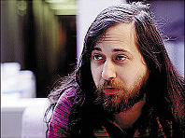
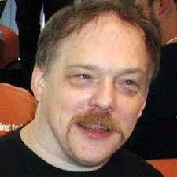
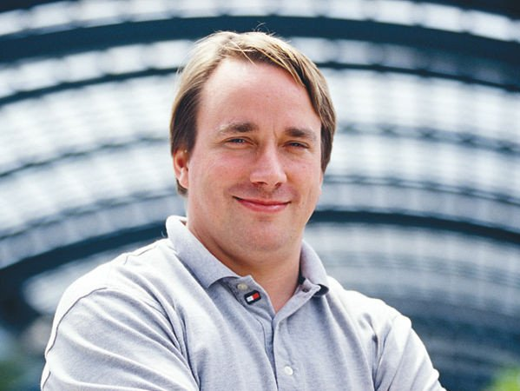
Richard Stallman
Eric Raymond
Linus Torvalds

Slide 13
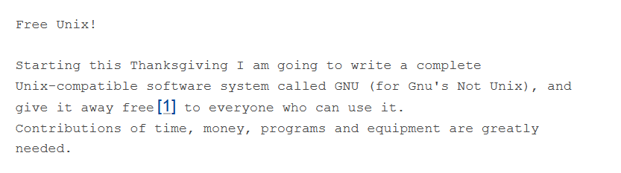
Launching of the GNU project in 1983

Slide 14
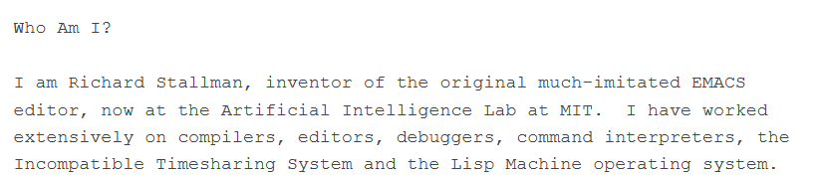
Launching of the GNU project in 1983

Slide 15
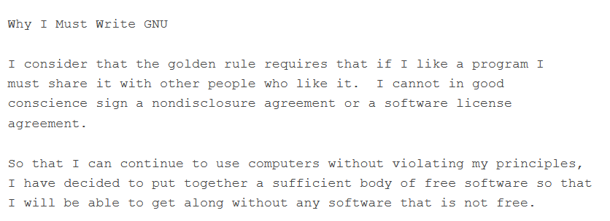
Launching of the GNU project in 1983

Slide 16
Launching of the GNU project in 1983
Almost complete in 1990

Slide 17
What motivated Richard Stallman?
His belief that
computer programs are easier to copy and modify.
Relevance of social needs
availability of information
freedom for its citizens to control their own lives.
the spirit of voluntary cooperation.
system that says you are not allowed to share or change software—is antisocial, unethical
His stance that free software is a matter of freedom, not price.
Economics is important no doubt.
“Some people write useful software for the pleasure of writing it or for admiration and love; but if we want more software than those people write, we need to raise funds.”
“Free as in freedom, not free as in beer,”

Slide 18
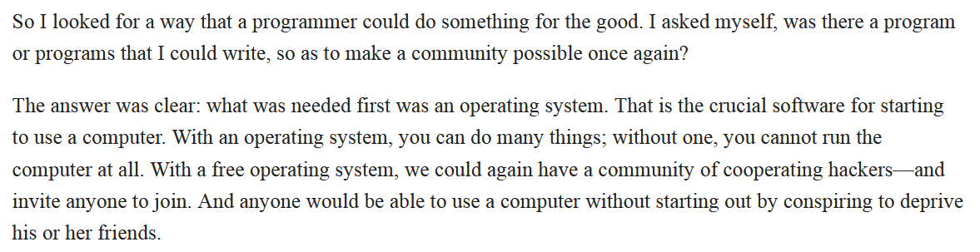
What motivated Richard Stallman?
Vanishing software-sharing community in the neighbouhood and a failed attempt to customize a printer in office for lack of access to its source code was the last straw .
Stallman wanted to liberate code from proprietary use.
Contributions of time, money, programs and equipment are greatly needed.
and the occasional use of the Spanish word libre, rather than gratis, to refer to free software, in order to distinguish between these two meanings.
"Gratis" pertains to being able to access and use the code, without a price-barrier, while "libre" pertains to being allowed to modify and re-use the code, without a permission barrier.

Slide 19
GNU, is a recursive acronym meaning “GNU's Not Unix”—
GNU gets the technical ideas of Unix.
But gives its users freedom to read and adapt code
The principal goal of GNU is to be free software.
Though no technical advantage over Unix,
But a social advantage
allowing users to cooperate, and
an ethical advantage,
respecting the user's freedom.

Slide 20
Richard Stallman quit the job at MIT in 1984 for creating a new software-sharing community.

Slide 21
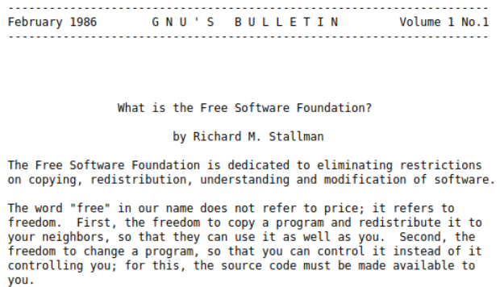
the Free Software Foundation (FSF)
In 1985, a tax-exempt charity for free software development.
the organizational home for the GNU Project
The FSF also took over the GNU Emacs tape distribution business;
later it extended this by adding other free software (both GNU and non-GNU) to the tape,
and by selling free manuals as well.

Slide 22

FSF India is a non-profit organisation committed to advocating, promoting and propagating the use and development of swatantra software in India.
https://fsf.org.in/

Slide 23
GNU Project.
Programming languages, such as Perl and Python,
and Internet software, such as BIND, sendmail, and Apache, demonstrated that free software was already ubiquitous and influential.

Slide 24
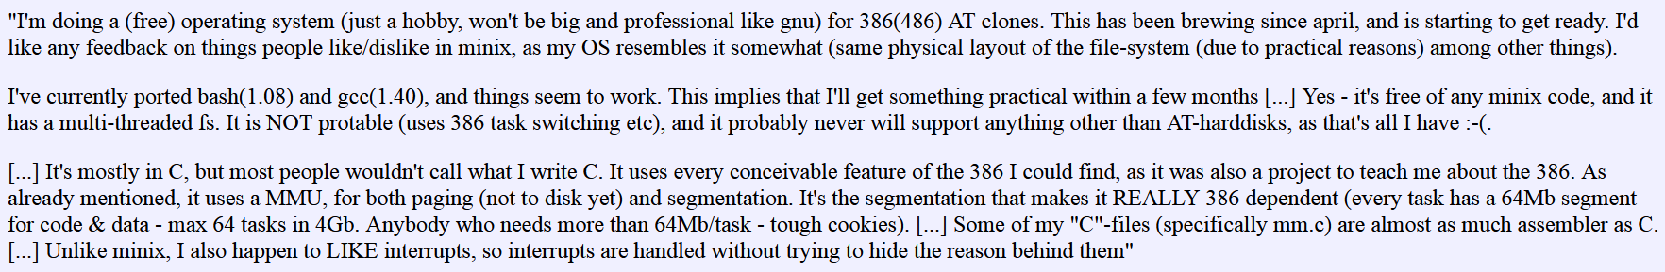
Linux arrives in 1991
Linus Torvalds,
21 year old Finnish computer science student.
Finish wunderkid

Slide 25
Linux arrives in 1991
In 1991, the last major essential component of a Unix-like system was developed:
Linux, the free kernel written by Linus Torvalds,
Other people joined to collaboration to create the GNU/Linux operating system.
It was proprietary at first, but in 1992, he made it free software;
Combined Linux with the not-quite-complete GNU system resulted in a complete free operating system.
a substantial job in itself, of course..
GNU/Linux, is a combination of the GNU system with Linux as the kernel.
“Please don't fall into the practice of calling the whole system “Linux,” since that means attributing our work to someone else.”

Slide 26
Threats to Free Software
Secret hardware specification.
To write free software to communicate with a device if there is no specification to use the device.
Proprietary software in classroom
Teaching young students only the proprietary software makes the whole ecosystem dependent on it.

Slide 27
Counter culture
It is a mistake to associate GNU with the term “open source”—that term was coined in 1998 by people who disagree with the Free Software Movement's ethical values.
They use it to promote an amoral approach to the same field.
Open source developers were frequently characterized as “hobby” developers (most famously in Bill Gates’s 1976 “Open Letter to Hobbyists,” which we’ll get to later), because the assumption was that only companies could make “real” software.
Once companies started using open source for commercial purposes, and people realized that these “hobby projects” were able to compete with the software made by paid employees, scholars had to come up with a new framework to explain this behaviour.
By contrast, the open source projects attracting attention in the late 1990s and early 2000s
the Linux kernel, which powers operating systems;
Apache, an HTTP server;
FreeBSD, an operating system;
GNOME, a desktop environment
were produced by distributed groups of developers that transcended employer affiliations.

Slide 28

From: Free software To: Open source Software

Slide 29
The Freely Redistributable Software Conference
First conference on free software
In 1996 sponsored by the Free Software Foundation
With keynotes from Linus Torvalds and Richard Stallman
The dividing line separating Linux developers from GNU/Linux developers was largely generational.
Stallman representing the older, wiser contingent of ITS/Unix
Torvalds representing the younger, more energetic crop of Linux hackers
A welcome event for Eric S. Raymond
Active in the GNU Project during the 1980s

Slide 30
The Cathedral and the Bazaar
The essay written by Eric S. Raymond in 1998.
It contrasted the management styles of the GNU Project with the management style of Torvalds
The paper drew its name from Raymond's central analogy.
GNU programs were "cathedrals," impressive, centrally planned monuments to the hacker ethic, built to stand the test of time.
Linux, on the other hand, was more like "a great babbling bazaar," a software program developed through the loose decentralizing dynamics of the Internet.
‘cathedral’ (centralized, closed, controlled) and ‘bazaar’ (decentralized, open, peer-review-intensive)

Slide 31
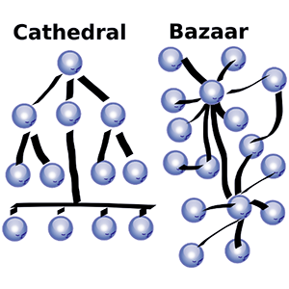
Development Style
GNU
Linux
Decentralized, Open,
Peer-review-intensive
Centralized,
Closed,
Controlled

Slide 32
Cathedral vs Bazaar
Rather a comparison of Stallman’s and Torvalds’s management styles.
Stallman belongs to the cathedral style
Torvalds is like a dinner-party host.
Let others lead the discussions and step in only when needed
Management means not to impose control but keep the ideas flowing.

Slide 33
Bazaar style attracted more attention: Too many cooks spoil the broth really!!!
Brooks' observation an incremental person when added to a project makes it take more, not less time.
In 1975 book, The Mythical Man-Month,
Brooks' Law held that adding developers to a project only resulted in further project delays.
Bazaar style software development averse
Raymond observed it as revolutionary.
Torvalds’s development style
Resulted in better software

Slide 34
Netscape Communications releases source code of its web browser
Influenced by Raymond’s writings
Web browser source code released
codenamed "Mozilla“
Netscape Navigator market shares of up to 80% in 1996.
Microsoft bundles Internet Explorer with Windows 95
Netscape Navigator to gradually lose market share.
In 1998 Netscape announced to distribute a large part of its navigator code as free software
launching the Mozilla project

Slide 35
R the programming language for statistics released as Free software
Ross Ihaka and Robert Gentleman, authors of the language
Convinced by statistician Martin Mächler to release it under the GNU General Public License

Slide 36
Free Software turned off businesses
the message still wasn't getting through
That the word "free" in free software stood for freedom and not price
The term interpreted as "zero cost,"
Different options
Sourceware
Source code available
freely distributable
cooperatively developed

Slide 37
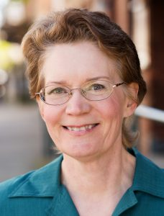
From: Sourceware, Source code available to: Open Source Software
Christine Peterson
executive director at Foresight Institute
https://opensource.com/article/18/2/coining-term-open-source-software

Slide 38
Role of free software in running the Internet
Growing commercial interest in
GNU/Linux, a complete operating system
Apache, a popular free software web server,
Need to publicize

Slide 39

the Freeware Summit
In 1998 Hosted by Tim O'Reilly,
publisher of O'Reilly & Associates
the first "Open Source Summit."
At the end of the one-day conference, attendees put the three terms-
free software, open source, or sourceware-
up for voting.
According to O'Reilly, 9 out of the 15 attendees voted for "open source.“
In 1998, Eric Raymond proposed launching the Open Source Initiative, or OSI, an organization that would police the use of the term "open source" and provide a definition for companies interested in making their own programs.
Profit motives separates OS movements

Slide 40
Tiemann a summit attendee says.
"Open source positioned itself as being business friendly and business sensible. Free software positioned itself as morally righteous. For better or worse we figured it was more advantageous to align with the open source crowd.”

Slide 41
The Linux world show in 1999
Stallman preferred to stick with the term free software.
But he didn’t reject the idea of open source per se.

Slide 42
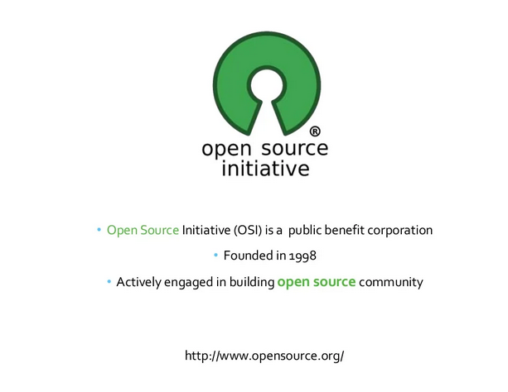
In 1998, the Open Source Initiative (OSI) was founded
Adopted the term open source software as a brand for introducing free software into the business world,
To avoid the ambiguous term free software (which can be misinterpreted as free to use as well as free of charge).

Slide 43
The two concepts are only culturally distinct: Ideology vs Pragmatics
The definitions of “free” and “open source” software are
only that the two concepts are culturally distinct.
Free software is a “a movement for freedom and justice.”
code should be liberated from proprietary control.
Free software developers has this ideology
They don’t like to mix these terms.
Open source advocates set pragmatic goals
such as standard Open source licenses offer greater liberties than the GPL.
Allow mixing proprietary and open-source software.”

Slide 44
Difference in values
.
For the Open Source movement
whether software should be open source
a practical question, not an ethical one.
non-free software is a suboptimal solution
For the Free Software movement
Non-free software is a social problem and free software is the solution.

Slide 45
A viewpoint worth consideration
We are not against the Open Source movement, but we don't want to be lumped in with them.
We acknowledge that they have contributed to our community, but we created this community, and we want people to know this.
We want people to associate our achievements with our values and our philosophy, not with theirs.
We want to be heard, not obscured behind a group with different views.
To prevent people from thinking we are part of them, we take pains to avoid using the word “open” to describe free software, or its contrary, “closed,” in talking about non-free software.
So please mention the Free Software movement when you talk about the work we have done, and the software we have developed—such as the GNU/Linux operating system.

Slide 46
FLOSS Projects Timeline
1987 PERL
1990 Python
1992 GNU/Linux
1994 PHP
1994 Blender
1995 MySQL
1995 Apache web server
1995 R
1996 cURL
1996 PostGreSQL
1998 OpenSSL
2001 Eclipse
2002 OpeneOffice
2003 Firefox, WordPress
2004 Ubuntu
2005 Git
2006 Apache Hadoop
2008 Android
2013 Docker
2014 vue.js
2015 Kubernetes
2015 Tensor‐Flow
2021 Apache MXNet

Slide 47
The major players in computing—such as Amazon, Apple, Facebook, Google, IBM, Intel, Microsoft incorporate FLOSS .
Among the leaders in the IT market, only Microsoft has positioned itself in clear opposition to free software and particularly software distributed under the GPL licence.

Slide 48
FLOSS Evolution
Development Processes
Hosting Platforms

Slide 49
Hosting Platforms (the tarball approach)
Open source code was distributed in the form of a .tar file as a “tarball”.
Developers used mailing lists to communicate and collaborate.

Slide 50
Hosting Platforms (source management systems)
CVS (Concurrent Version System) in 1980s.
It uses a central repository accessed through a client/server system.
The site administrator decides who has access to the repository, or to which parts of the repository.
Subversion

Slide 51
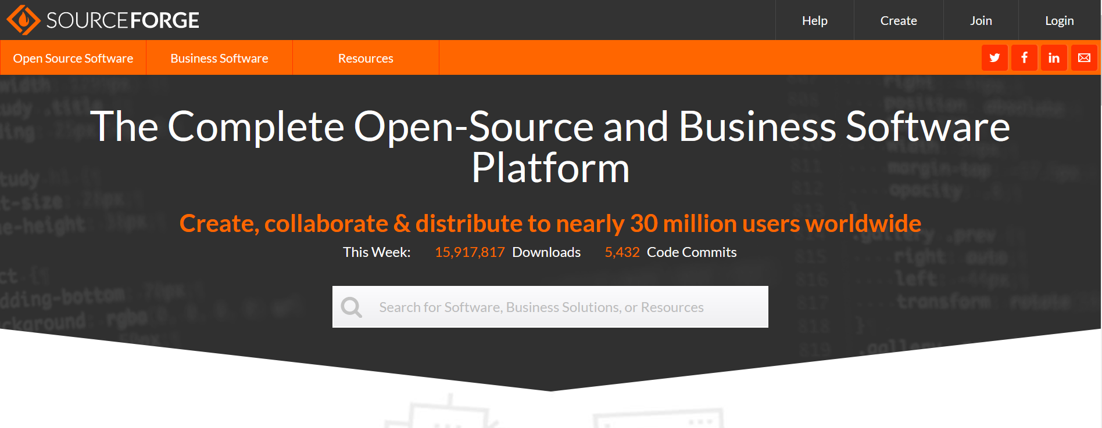
Development support sites
https://sourceforge.net/

Slide 52
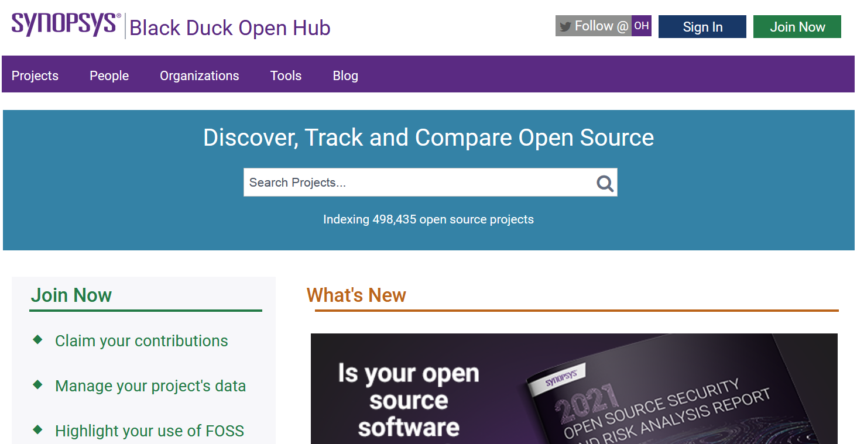
Development support sites
https://www.openhub.net/

Slide 53
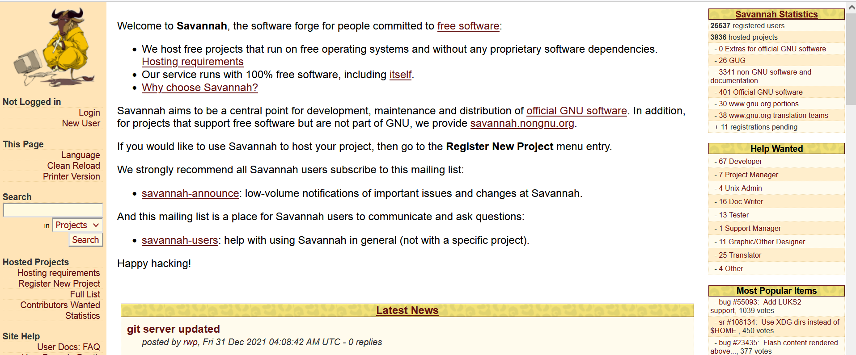
Development support sites
https://savannah.gnu.org/

Slide 54
Hosting Platforms (The Arrival of Git)
Git, the most popular version control system today, was released in 2005.
Created by Linus Torvalds
Before that, developers primarily used centralized version control systems, such as Subversion or CVS, if they used version control at all.
These systems weren’t designed for decentralized collaboration at scale.

Slide 55
Hosting Platforms (The Arrival of Github)
GitHub founded in 2008
GitHub itself is not open source.
acquired by Microsoft in 2018
Microsoft CEO called Open Source “a cancer that attaches itself in an intellectual property sense to everything it touches” in 2001
GitHub’s next-closest competitor, GitLab, launched in 2011, is open source.
However, GitHub is still by far the dominant market player.
Notes:
Both free and early open source advocates were preoccupied with evangelizing the idea of open source, whether for ideological or business reasons.
But today’s developers hardly even notice “open source” as a concept anymore. They just want to write, share, and discover code.

Slide 56
Hosting Platforms Convenience triumphing over personal values
Developers choose GitHub over GitLab
comfortable to use, and
better tool support.
Developers doesn’t seem much care about using the distinction between free and open source software.
Sharing code is more like sharing any other form of content nowadays.
For them developing solutions looks more important than the business model of the supporting platform.

Slide 57
Development Processes
Community Supported Projects
Projects’ described as a commons, meaning a resource that is owned, used, and managed by a community.
The Cathedral Style
The Bazaar Style
Foundation Backed Projects
Corporate Supported Projects

Slide 58
Community Based Projects
Successful free/libre open source projects operated like communities,
relying upon self-governed rules, rather than outside intervention,
The community members are volunteers motivated
For fulfilling a need,
For learning, for earning reputation in the community as well as
By psychological needs involving self-fulfillment, basic fun and enjoyment

Slide 59
The Cathedral Style
Highly centralised
a few people are responsible for the software's design and implementation.
Well defined tasks
Volunteers assigned tasks.
Strictly scheduled releases
For example, GNU

Slide 60
The Bazaar Style
No absolute authority to control the processes or to strictly plan what has to happen.
At the same time, participants‘ roles can change continuously (sellers can become clients) and with no outward indication.
For example, Linux

Slide 61
Foundation Based Projects
Clustered projects sponsored by foundation
Common license model
Mix of paid and volunteer developers
Apache; Eclipse, LibreOffice
Meritocracy
E.g. Contributors with important and continuous contributions only can become members of the Apache Foundation.
Motivation
To improve some system
To solve a problem
Funding
Public funding
Private not-for-profit funding
Indirect funding

Slide 62
Corporate involvement in OSS Projects
Sharing the burden
Developing solutions jointly for common problems
The advantages are obvious: benefits for all at divided costs.
In other cases, companies may also seek to collaborate in free projects promoted by volunteers,
The GNOME Foundation
make volunteers collaborate with their own free projects.
Red Hat

Slide 63
Corporate involvement in OSS Projects
Usually those external entities determine how the funds are to be spent, and where the development efforts are headed.
The developer just follows those more or less strict guidelines.
In some sense, it could be said that the external entity `sponsors' the development of some given open source software.
Three models, according to who funds the project and why.
public funding,
‘needed improvement' funding, and
indirect funding.
Today each of these kinds of free software business is practiced by a number of corporations.

Slide 64
Practice of supporting the OSS developers
If open source code is like infrastructure, we want to measure its value based on a combination of
dependencies (Who uses the code?) and
substitutability (If this code disappeared, how hard would it be to replace?).
Sponsorships managed through Patreon and GitHub Sponsors (a platform-native sponsorship product launched by GitHub in 2019).

Slide 65

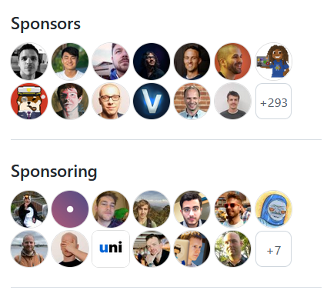
A newer practice of open source developers raising money
from their fans and users,
independent not just of a salaried job but of a specific project.
https://github.com/sponsors/sindresorhus

